Slide 1
Analyzing the Impact of Car Features on Price and Profitability
By- Shweta Kushwaha

Slide 2
Project Description
The automotive industry has been rapidly evolving over the past few decades, with a growing focus on fuel efficiency, environmental sustainability, and technological innovation. With increasing competition among manufacturers and a changing consumer landscape, it has become more important than ever to understand the factors that drive consumer demand for cars.
In recent years, there has been a growing trend towards electric and hybrid vehicles and increased interest in alternative fuel sources such as hydrogen and natural gas. At the same time, traditional gasoline-powered cars remain dominant in the market, with varying fuel types and grades available to consumers.
For the given dataset, as a Data Analyst, the client has asked How can a car manufacturer optimize pricing and product development decisions to maximize profitability while meeting consumer demand?
This problem could be approached by analyzing the relationship between a car's features, market category, and pricing, and identifying which features and categories are most popular among consumers and most profitable for the manufacturer. By using data analysis techniques such as regression analysis and market segmentation, the manufacturer could develop a pricing strategy that balances consumer demand with profitability, and identify which product features to focus on in future product development efforts. This could help the manufacturer improve its competitiveness in the market and increase its profitability over time.

Slide 3
Approach
Understanding the data and cleaning
Read and understand the data then check for null & missing values to clean the data before analysis. And found that there are some columns have blank cell and column named MODEL has irrelevant data such as dates.
So first I treated this column and replace all dated values with N/A. because every car have some unique feature that lead to different models name so it can't be deleted.
Used =COUNTBLANK function to find missing values and. 11 found that there are some columns suchas Engine HP, Engine fuel type, Engine cylinder and No. of doors have some missing values.
To treat the missing values I have entered these values with =MEDIAN function in order to get appropriate values to fill the blank cell.
Thereafter I've treated column engine fuel type which contain categorical values so I replaced the blank cell with N/A values so that they are not included in the analysis or cause error result.

Slide 4
Tech-stack used
I used Microsoft excel to read and convert the data frame according to our needs.
I used Microsoft PowerPoint to make the report and graphs to represent the project report clearly.

Slide 5
PART-1
ANALYSIS

Slide 6
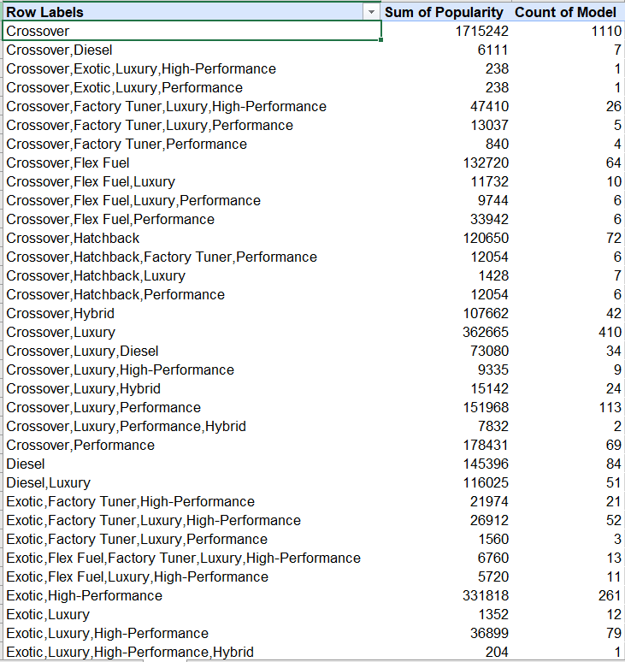
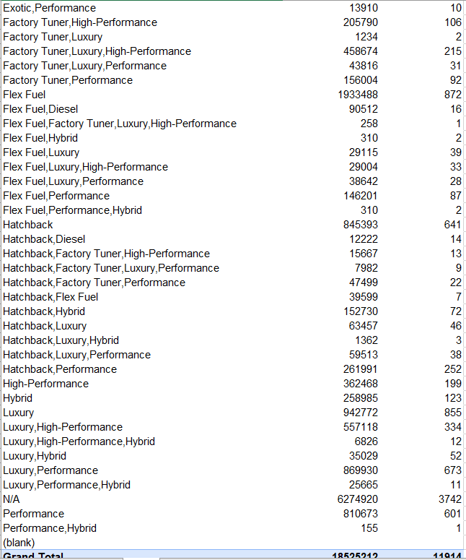
Task 1.A: Create a pivot table that shows the number of car models in each market category and their corresponding popularity scores.

Slide 7
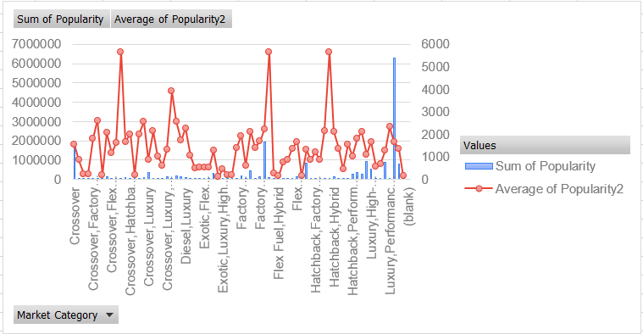
Task 1.B: Create a combo chart that visualizes the relationship between market category and popularity.

Slide 8
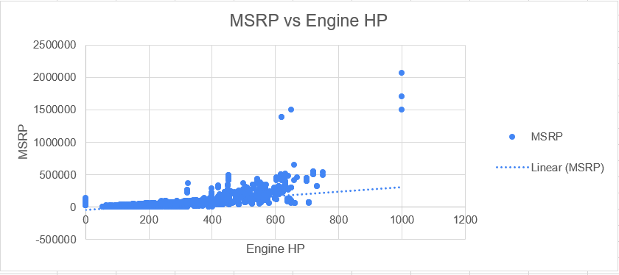
Task 2: Create a scatter chart that plots engine power on the x-axis and price on the y-axis. Add a trendline to the chart to visualize the relationship between these variables.
Graph shows positive trendline that indicate there is a positive relationship between car’s engine power and price meaning that cars with more powerful engine tend to be more expensive.

Slide 9
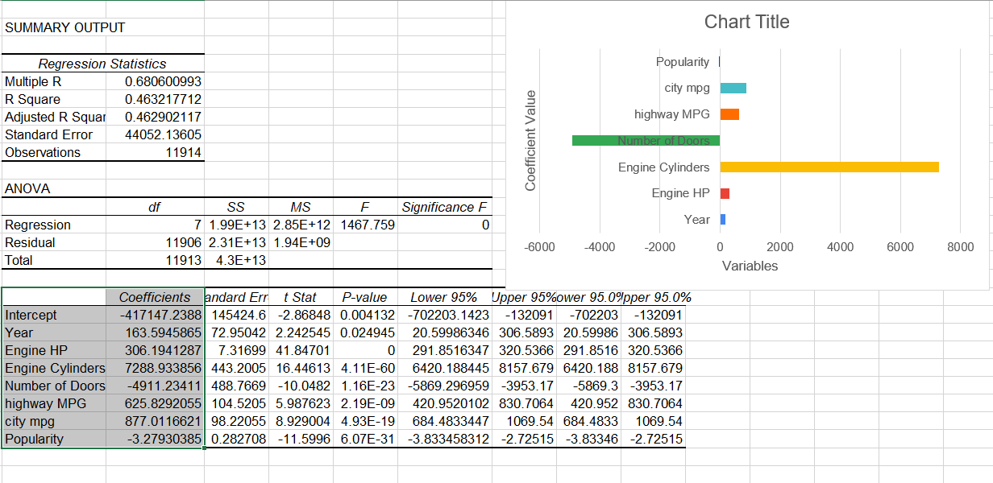
Task 3: Use regression analysis to identify the variables that have the strongest relationship with a car's price. Then create a bar chart that shows the coefficient values for each variable to visualize their relative importance.
In chart showed that Engine cylinders had the strongest positive relationship with price, followed by city mpg, highway mpg, engine hp and year. Whereas, number of doors and popularity had negative relationship with price which shows that cars with more doors tend to be less expensive.

Slide 10
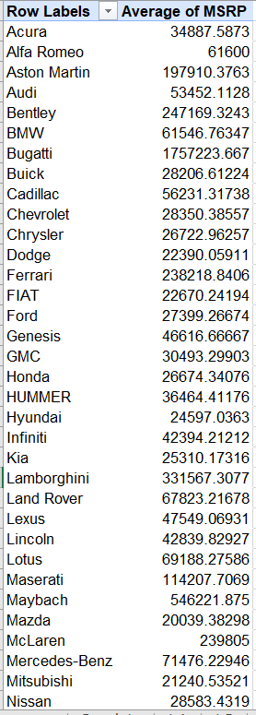
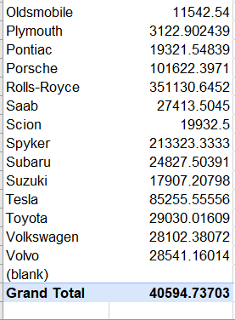
Task 4.A: Create a pivot table that shows the average price of cars for each manufacturer.
This analysis provide insights that how prices vary within each manufacturer, and whether certain manufacturers tend to have more expensive or less expensive cars overall.

Slide 11
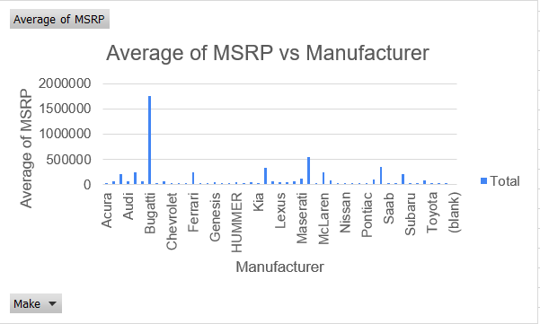
Task 4.B: Create a bar chart or a horizontal stacked bar chart that visualizes the relationship between manufacturer and average price.
The chart shows the Bugatti cars have highest average price across different manufacturers.

Slide 12
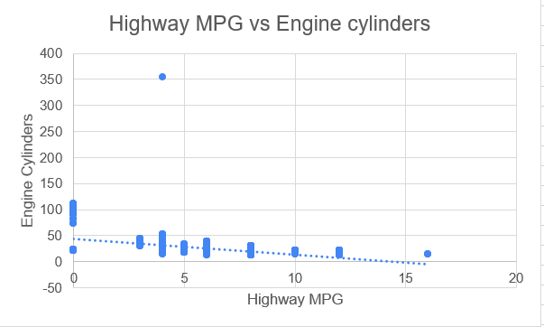
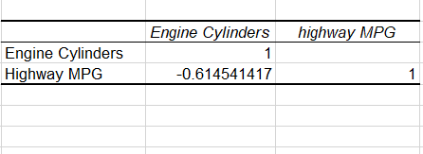
Task 5.A: Create a scatter plot with the number of cylinders on the x-axis and highway MPG on the y-axis. Then create a trendline on the scatter plot to visually estimate the slope of the relationship and assess its significance. Task 5.B: Calculate the correlation coefficient between the number of cylinders and highway MPG to quantify the strength and direction of the relationship.
Result shows that there is a negative correlation between the number of cylinders and highway MPG i.e, the number of cylinders in the engine increases the fuel efficiency of the car decreases.
The graph shows that the slope of trendline is negative which indicates a decrease in highway MPG with an increase in the number of cylinders.

Slide 13
PART-2
BUILDING THE DASHBOARD

Slide 14
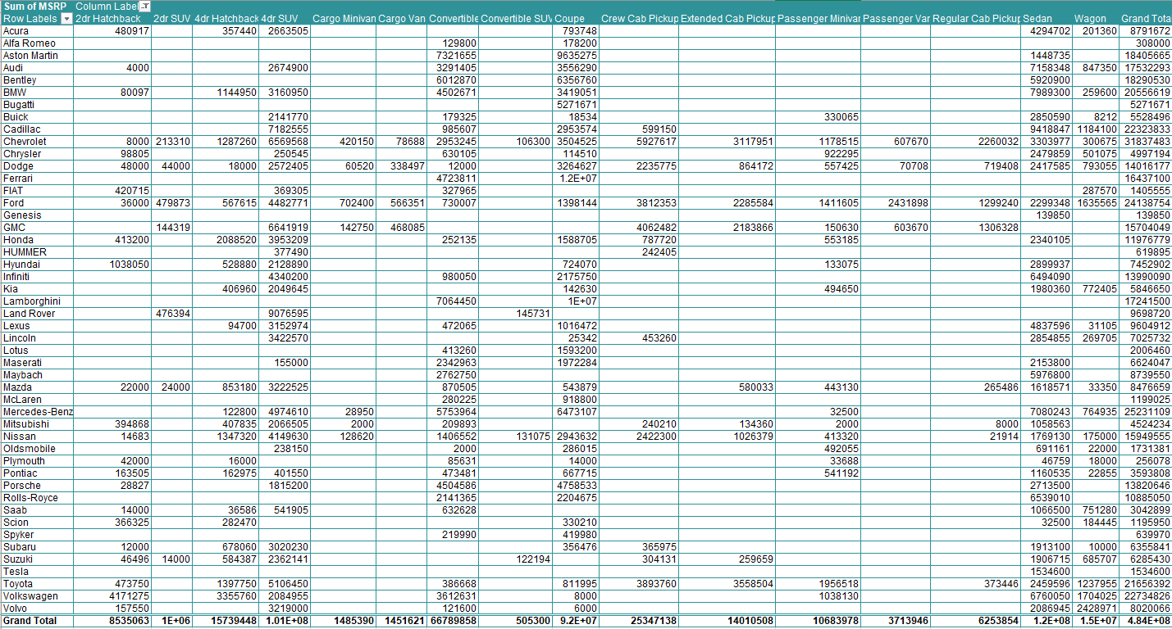
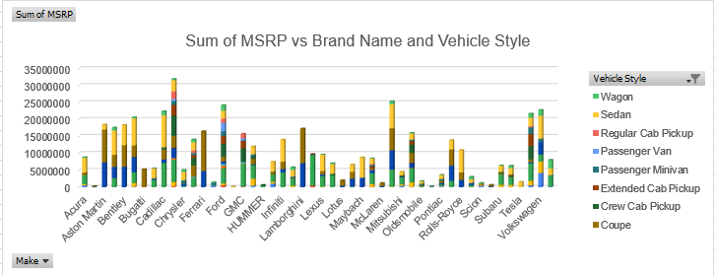
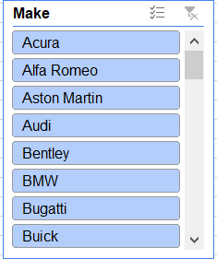
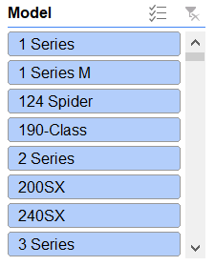
Task 1: How does the distribution of car prices vary by brand and body style? Hints: Stacked column chart to show the distribution of car prices by brand and body style. Use filters and slicers to make the chart interactive. Calculate the total MSRP for each brand and body style using SUMIF or Pivot Tables.
This result provide insights that how car prices vary by brand and body style which can be helpful to manufacturers to optimize their pricing strategies and increase profitability. Slicers will help in providing more specific details about the data.

Slide 15
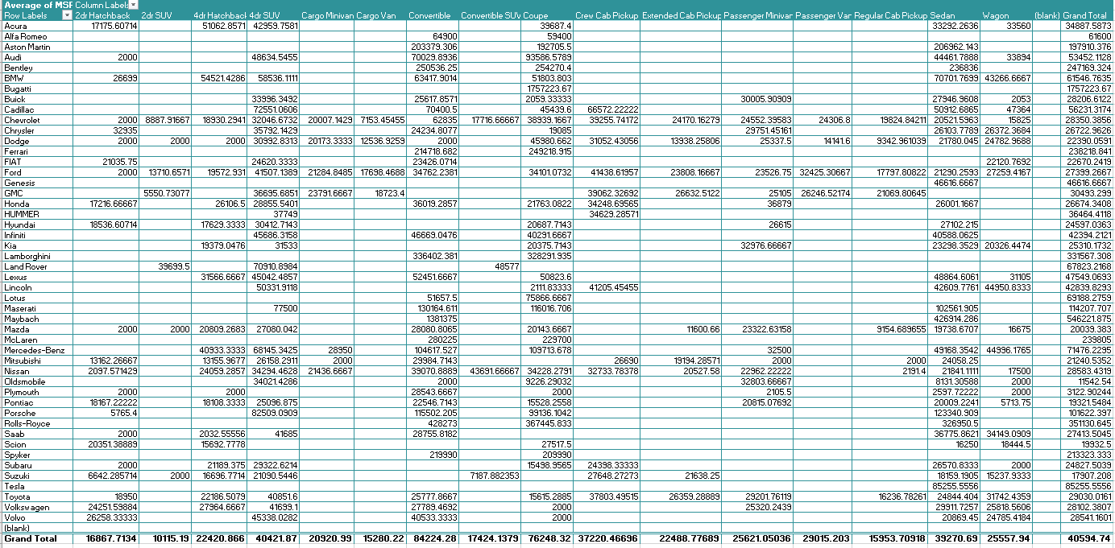
Task 2: Which car brands have the highest and lowest average MSRPs, and how does this vary by body style? Hints: Clustered column chart to compare the average MSRPs across different car brands and body styles. Calculate the average MSRP for each brand and body style using AVERAGEIF or Pivot Tables.

Slide 16
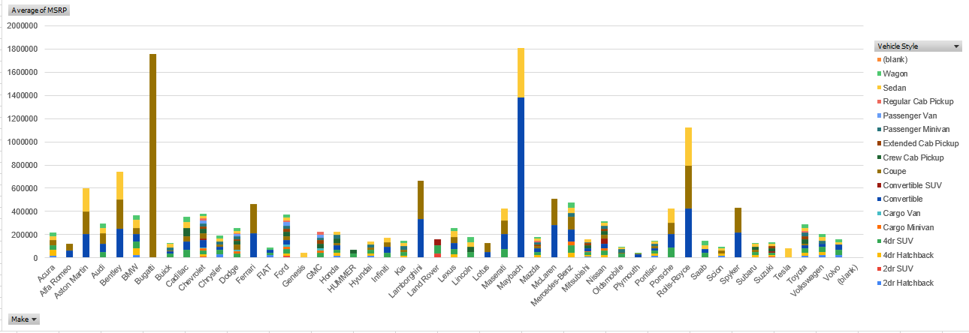
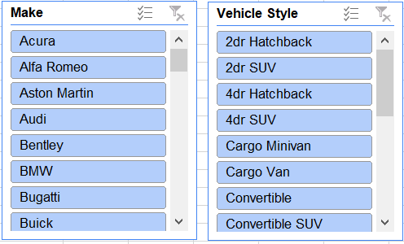
Bugatti, Maybach and Rolls-Royce tend to have a higher average MSRP compared to other brands such as Tesla, BMW and Audi. Similarly, Sedan and Extended Cab pickup tend to have higher average MSRP compare to others.

Slide 17
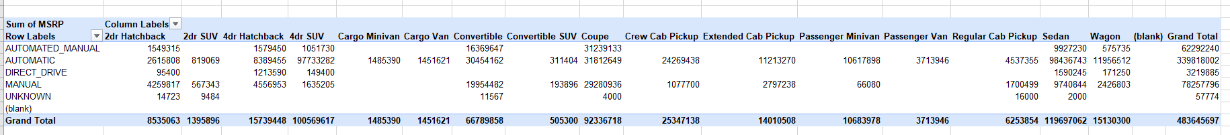
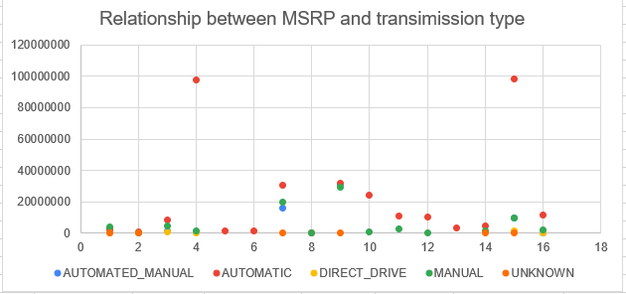
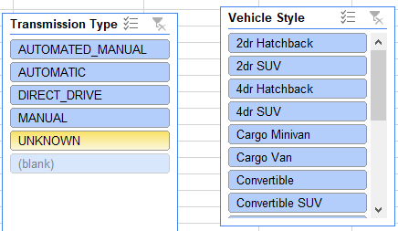
Task 3: How do the different feature such as transmission type affect the MSRP, and how does this vary by body style? Hints: Scatter plot chart to visualize the relationship between MSRP and transmission type, with different symbols for each body style. Calculate the average MSRP for each combination of transmission type and body style using AVERAGEIFS or Pivot Tables.

Slide 18
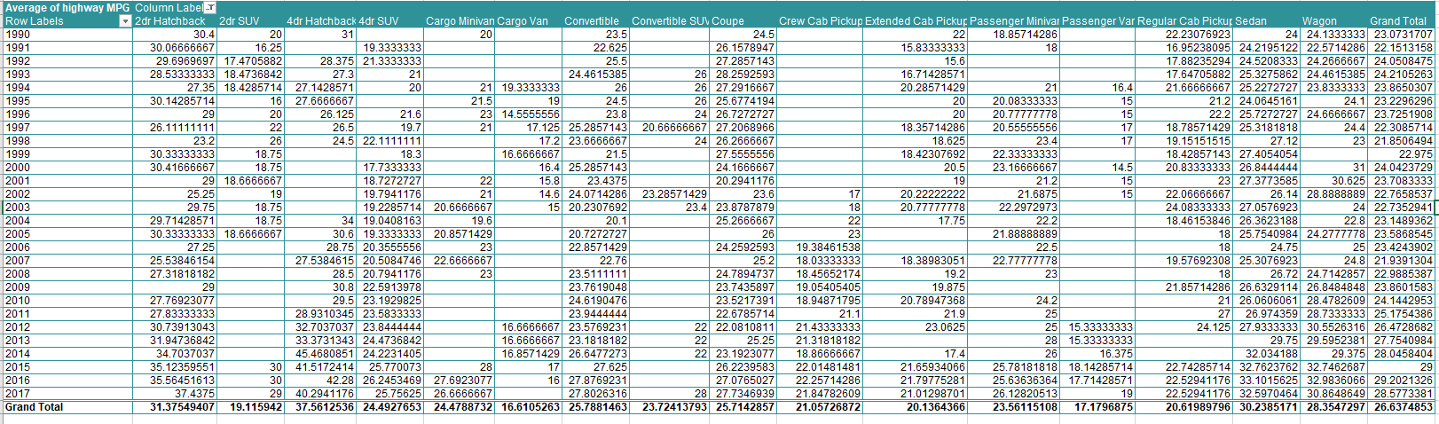
Task 4: How does the fuel efficiency of cars vary across different body styles and model years? Hints: Line chart to show the trend of fuel efficiency (MPG) over time for each body style. Calculate the average MPG for each combination of body style and model year using AVERAGEIFS or Pivot Tables.

Slide 19
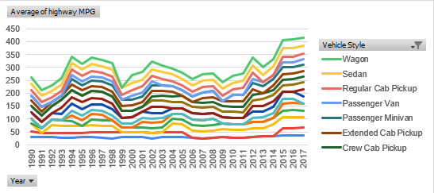
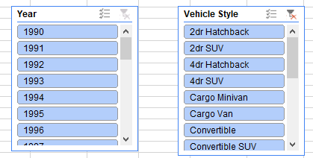
The result shows that fuel efficiency has changed over time for different vehicle styles such as 4dr hatchback and 2dr hatchback tend to be more fuel efficient.

Slide 20
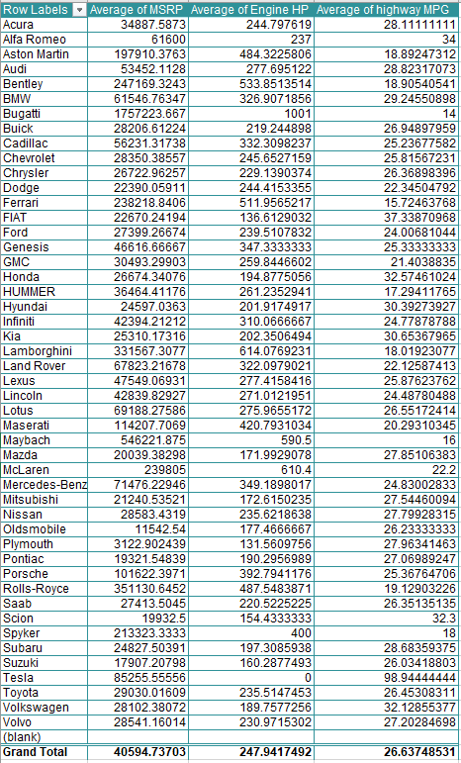
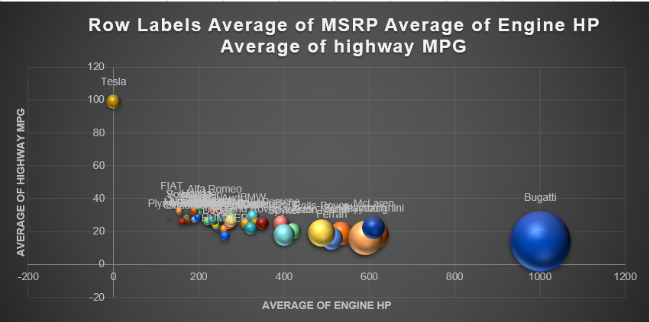
Task 5: How does the car's horsepower, MPG, and price vary across different Brands? Hints: Bubble chart to visualize the relationship between horsepower, MPG, and price across different car brands. Assign different colors to each brand and label the bubbles with the car model name. Calculate the average horsepower, MPG, and MSRP for each car brand using AVERAGEIFS or Pivot Tables.
The analysis shows that high average engine horse power and highway MPG are having by some popular brands such as BMW, Audi and many more, while others have lower average horse power and average MPG and MSRP.

Slide 21
INSIGHTS
Engine cylinders had the strongest positive relationship with price, followed by city mpg, highway mpg, engine hp and year. Whereas, number of doors and popularity had negative relationship with price which shows that cars with more doors tend to be less expensive.
Prices vary within each manufacturer, and whether certain manufacturers tend to have more expensive or less expensive cars overall.
It shows how car prices vary by brand and body style which can be helpful to manufacturers to optimize their pricing strategies and increase profitability. Slicers will help in providing more specific details about the data.
Bugatti, Maybach and Rolls-Royce tend to have a higher average MSRP compared to other brands such as Tesla, BMW and Audi. Similarly, Sedan and Extended Cab pickup tend to have higher average MSRP compare to others.
The result shows that fuel efficiency has changed over time for different vehicle styles such as 4dr hatchback and 2dr hatchback tend to be more fuel efficient

Slide 22
RESULT
This project helps in understand why data cleaning is most important step in analysis a particular dataset.
Gained deeper knowledge on how we can find regression in the dataset and how important they are to identify
How to draw chart based on different scenarios and pivot tables
Finding the correlation between different variables.
For analysis you can visit excel, please click here

Slide 23
Thank you!

